Slide 1

WHAT YOU NEED TO KNOW ABOUT FINANCIAL AID
Parent Night Presentation
Notes:
Brittany from Helena
Introductory slide . . .
NOTE: All of the people in the presentation are Montana students, parents, educators, and even a few Outreach managers from SAF. We took these pictures spring 2015 throughout the state.

Slide 2

Topics to be discussed:
What is financial aid?
Where does it come from? How do I get it? Am I eligible?
What is the FAFSA?
Important Dates and Deadlines
Completing the FAFSA – helpful hints
The Financial Aid Process
COA, EFC, Need
Types of aid
New this year
Special circumstances
Other Forms, Resources
Paying The Bill
Notes:
Here is what we’ll be talking about tonight – Lots of information, so let’s get started!

Slide 3

What is financial aid?
Where does it
come from?
Funds to help students and families pay for post-secondary expenses.
Many sources – federal, state, local, institutional, employers, civic organizations, private donors etc.
Notes:
Lynn Sellegren (counselor) from Bozeman

Slide 4

How do I get Financial Aid?
Apply for an FSA-ID
Complete the FAFSA
Apply early
Apply for Scholarships
Follow instructions
Pay attention to/meet all deadlines
Apply EVERY YEAR
Notes:
Henry from Columbia Falls

Slide 5

Am I eligible to receive financial aid?
Every family who applies can receive some type of aid
Non-need based student loans are available to any student
Student must have HS Diploma, GED, HiSet, or homeschool completion certificate
Exceptions:
If you are in default on a federal student loan
If you owe a refund on a federal grant
If you are male 18 or over and do not register for Selective Service
If you have certain drug convictions
If you are not a US citizen or eligible non-citizen
Notes:
MALES – must register when they turn 18!
WHAT IS AN ELIGIBLE NON-CITIZEN? If asked: From the FAFSA for 2015-2016: “If you are an eligible noncitizen, YOU WILL HAVE AN eight- or nine-digit Alien Registration Number. Generally, you are an eligible noncitizen if you are:
a permanent U.S. resident with a Permanent Resident Card (I-551);
a conditional permanent resident with a Conditional Green Card (I-551C);
the holder of an Arrival-Departure Record (I-94) from the Department of Homeland Security showing any one of the following designations: “Refugee,” “Asylum Granted,” “Parolee” (I-94 confirms that you were paroled for a minimum of one year and status has not expired), T-Visa holder (T-1, T-2, T-3, etc.) or “Cuban-Haitian Entrant;” or
the holder of a valid certification or eligibility letter from the Department of Health and Human Services showing a designation of “Victim of human trafficking.”
NOTE: If you are in the U.S. and have been granted Deferred Action for Childhood Arrivals (DACA), an F1 or F2 student visa, a J1 or J2 exchange visitor visa, or a G series visa (pertaining to international organizations), select “No, I am not a citizen or eligible noncitizen.”
You will not be eligible for federal student aid. If you have a Social Security Number but are not a citizen or an eligible noncitizen, including if you have been granted DACA, you should still complete the FAFSA because you may be eligible for state or college aid.

Slide 6

What the Heck is the FAFSA?
FREE Application for Federal Student Aid
Standard form collects info about student & family
Determines eligibility for Federal, state, local aid
Determines “Financial Need” and “EFC”
Notes:
Financial need and “EFC” = will be defined later

Slide 7

What is the FAFSA?
Used by scholarship committees to award need-based scholarships
Not a scholarship app
E-filing recommended
Takes most people 21 minutes to complete
Help is available!
www.fafsa.gov
Notes:
Meleina (HS Counselor/Educator) from Missoula
The FAFSA is a consistent source for schools to use when determining eligibility for need-based scholarships.
Note: fafsa.com is out of business!

Slide 8

What is the FAFSA form used for?
Use FAFSA to determine eligibility and apply for:
Grants
Work Study
Loans
Some State aid
Use different applications for:
Scholarships
Student Loans Athletic Waivers – usually a separate process – contact the Athletic Dept.
Notes:
Athletic waivers are separate from a school’s scholarship process.
Montana no longer has state grant programs – but we do have the MUS Scholarship programs.

Slide 9
Important Dates – FAFSA Priority Date
Submitting FAFSA by this date may mean additional “priority” funding
Limited additional grants, work-study, institutional funds
Priority funds – to earliest applicants/neediest students
Especially important for needy families to meet priority dates
NOTE: Pell Grant, Federal Direct Student Loans, Parent PLUS Loans are not affected by priority dates.
Bottom Line: Even if you miss a “priority” date, you still need to submit your FAFSA to qualify for other aid
Notes:
Difference between priority DATE and Deadlines

Slide 10
Important Dates
FAFSA Priority DATE for 2016-2017
February 15th – U of M
March 1st for most Montana schools
Check with your school
NOTE: May change for 2017-2018
Notes:
Difference between priority DATE and Deadlines

Slide 11
Important Deadlines – To Name a Few
Scholarship app deadline
Admissions deadline
Dorm app/deposit deadline
“Return award letter by” deadline
Course registration deadline
“Pay statement by” deadline - late fees, dropped classes
Withdrawal or drop classes without penalty – deadline
Assignment deadline
Notes:
Deadlines mean business – generally non-negotiable.

Slide 12

Completing the FAFSA
Why file electronically?
Speeds processing
Prevents costly errors (built-in edits)
Skips unnecessary questions
Optional (but recommended): Use IRS data retrieval tool to import tax data directly from IRS
Faster correction processing
Detailed instructions & help
Renewal FAFSA
Notes:
A FAFSA submitted electronically is usually processed within 72 hours. A paper FAFSA can take 8 – 12 WEEKS (more during peak processing times) to process and get information to the school . While you are waiting for your PAPER FAFSA to be opened and entered into the computer, money is being awarded to other students!
NOTE: Processing time at schools vary. They may receive 2,000 FAFSAs at a time, for example.

Slide 13

Completing the FAFSA - Frequent FAFSA errors
Wrong Social Security #s
Divorced/remarried parental information
Untaxed income
U.S. income taxes paid
Household size
Number in household/number in college
Assets/investments net worth
Notes:
Here are a few of the common areas where mistakes are made. Let’s review some of these problem areas.

Slide 14

Completing the FAFSA
Use accurate DOB, SSN, legal name from Social Security Card
Eligibility:
Must be degree-seeking
Must be making “SAP”
Pell eligibility - 12 semesters max
Notes:
SAP = Satisfactory Academic Progress – each school sets their own SAP policies – be sure you know what is expected of you. In general, you must be:
Maintaining at least a “C” average or 2.0
Passing at least 67% of your classes
Making progress toward a degree in a timely manner.
You only receive Federal aid for a certain amount of time – generally 150% of your program length. So if you are earning a four-year bachelor’s degree – you get 6 years to complete it. If you are earning a two-year degree, you get three years to complete, and so on. Effective on July 1, 2012, you can receive the Federal Pell Grant for no more than 12 semesters or the equivalent (roughly six years). You'll receive a notice if you're getting close to your limit. If you have any questions, contact your financial aid office .

Slide 15
Completing the FAFSA – Dependency Questions
Criteria to be independent (parent info not required):
Born before Jan. 1, 1993 (born in 1992 or before)
Working on a graduate degree (Completed Bachelors Degree)
Married, Veteran, Active Duty, or have dependents that you support more than 50%
Since turning age 13, was an orphan, in foster care, a dependent or ward of the court
Is currently designated by one of several agents/agencies as an unaccompanied youth who was homeless or self-supporting and at risk of being homeless
Was or is an emancipated minor or in legal guardianship

Slide 16

Student Dependency Questions
If all “No” responses – student is dependent
Provide parental information on FAFSA
If even one “Yes” response – student is independent
Do not provide parental information
Special circumstances affecting dependency can be considered
Notes:
Abbreviated slide option/shorter presentation (use instead of #16)

Slide 17

Special
Circumstances
Exceptions for dependency:
Abandonment
Abuse
Neglect
Student answers “no” to all dependency questions on FAFSA
Marks “I will not provide parental data”
Contact the financial aid office for assistance
Document
Notes:
NOTE: This slide is also SLIDE 50 with other Special Circumstance slide – you can show in either site. Hide or delete alternate location
In cases where safety of student would be compromised by contacting parents, the student can contact the financial aid office for assistance in establishing independent status. Documentation required.
NOTE: use here directly after dependency info or

Slide 18

Completing the FAFSA
Both the parent(s) and student report:
Taxable income
Untaxed income
Asset Info
Household Info
Parent information: PURPLE
Student information: ORANGE
Notes:
BE SURE TO REPORT STUDENT INFO IN ORANGE SECTIONS AND PARENTS IN PURPLE – CAN BE CONFUSING.
Find current colors at https://www.edvisors.com/fafsa/forms/tutorial/

Slide 19

Completing the FAFSA
Report taxed income using 2015 Federal tax return and W-2s
If taxes aren’t completed, use 2014 tax return as guideline to estimate along with final pay-stubs, W-2s
Report Untaxed income – child support, untaxed IRA distributions, payments to tax-deferred pensions, Worker’s Comp, contributions to Health Savings Accounts (HSAs)
For needy families – more important to meet priority dates than to wait for completed tax returns
Don’t miss out on priority aid - use estimates & update once taxes are filed

Slide 20

Completing the FAFSA
IRS Data Retrieval System
Retrieves federal tax data from IRS
Loads tax info into FAFSA
(Can’t be used when estimating)
FAFSA indicates tax info verified by IRS
No further verification needed
Voluntary
Available 2 - 3 weeks after you
electronically file taxes
Supposed to be available 1st week of February
Notes:
If you don’t use IRS data retrieval and are selected for verification, you must provide tax transcript from the IRS. A copy of your federal tax return will not be accepted. Data must come directly from IRS to ensure authenticity.

Slide 21

Whose information is reported on the FAFSA?
Confused yet?
Divorced/Separated/Remarried Parents:
1. Who did the student live with most in
the last 12 months?
If #1 isn’t clear, who provided the most financial support in last 12 months?
If neither #1 nor #2 is clear, choose the parent who most recently provided support.
Stepparent’s info is always included.
Note: Both legal parents’ (biological or adopted) incomes
are used if living together, regardless of marital status or gender.
Notes:
Lynn Sellegren (Counselor), Bozeman
If for some reason you are already living on your own, list the parent with whom you lived with the most prior to moving out.

Slide 22

Completing the FAFSA – Reporting Assets
Report net worth only:
Stocks, bonds, money markets, rental property, second home, etc.
Report current balances of cash, savings, checking (as of the day you complete the FAFSA – “a snapshot in time”).
May not be asked for this information
ASSET = something you own
that has value
NET WORTH = Value minus Debt
Notes:
Rex from Helena
In addition to reporting your parent and student’s income, you will report certain assets you may hold. An asset is simply something you own that has a value. And for FAFSA purposes, the value you will report is the net worth of that asset.
You may not be asked for this information - remember we talked about the beauty of the electronic application? Depending on what you report for income, family size, etc., your assets may or may not even be considered.

Slide 23

Completing the FAFSA – Don’t Report
Personal property or personal debt (cars, credit cards, etc.)
Balance in retirement accounts – IRAs, 401ks, Pensions, etc.
Value of life insurance

Slide 24

Completing the FAFSA – Do NOT Report:
Do NOT report these assets:
Family home you live in
Family farm you live on, own and
operate
Family Business (if you own/
control at
least 50%
and you
employ less
than 100
people
Notes:
You do not report any of these assets on the FAFSA – they are not considered when determining your families’ need or ability to contribute to your education

Slide 25

Additional Information
College and housing information
FAFSA preparer information
Certification/Statement of Educational Purpose
Once you sign and submit the FAFSA:
If you are a parent with more than one student in college – click on confirmation page to pre-fill your second student’s FAFSA
Notes:
Cree from Butte MT (and Schylar Canfield from SAF)
College and housing info – what colleges you want your info sent to (up to 10 can be listed)
The colleges you list can only see their name – they do not see the other colleges listed
Housing plan for college – on campus, off campus, with parent? Most schools require freshman to live on campus their first year – unless family in town
Certification of Statement of Educational Purpose – This is where you say you will use the money for education, you have provided true and accurate information on the FAFSA, etc.
Read before signing: Giving false or misleading information or using someone else’s FSA ID to complete the FAFSA comes with a $20,000 price-tag, or prison sentence, or both. You are signing a government document; your FSA ID constitutes a legal signature.
PARENTS: IF YOU HAVE MORE THAN ONE STUDENT WHO WILL ATTEND COLLEGE (AND FOR WHOM YOU HAVE TO PROVIDE PARENTAL DATA ON THE FAFSA) (once you click submit – DON’T LEAVE THE CONFIRMATION PAGE – find the question “Do you have another student for whom you need to complete a FAFSA? Click here – a new FAFSA will be pre-populated with all the parental data you have provided – then you just have the student complete his/her portion – HUGE TIME SAVER!

Slide 26

Strategies for maximizing aid eligibility
Be honest, ethical and within the law
Take advantage of how assets and income of student and parents are assessed - spend student's assets first
Convert included assets to non-included assets
Increase # of kids in college – EFC is split
Reduce income in base year– several ways
Max out retirement contributions (balances not reported)
For more information, see: http://www.finaid.org/fafsa/maximize.phtml
Notes:
Do not HIDE assets – for example, putting them into a sibling’s account where they will be unreported. This is FRAUD.
What you can do:
Spend student’s assets first – they are assessed at a higher rate than parents’ (20% of student’s assets are considered available)
Converting assets – take money from savings and put into retirement account, for example
More kids in college = EFC split
Reduce income during the base year - the tax year used to report on the FAFSA – example: If self-employed, draw less of a salary; ask a boss to withhold a bonus until after end of year
5. Max out retirement contributions
Reducing "included" assets. Converting included assets into non-included assets will increase eligibility by sheltering them from the need analysis process. However, most financial planners recommend that parents maintain a contingency fund equal to six months salary in relatively liquid form for emergencies and other unforeseeable circumstances.

Slide 27

FAFSA Processing Times
Once the FAFSA is submitted:
Print and keep your confirmation page
Timelines for Schools to receive your SAR:
1 – 3 days if FAFSA submitted electronically
4 – 6 weeks++ if paper FAFSA is mailed
School processing times vary
Notes:
NICOLE from Geyser
If you haven’t received any information within 3 weeks, contact the financial aid office at the college or the Federal Processor at 1.800.4.FEDAID (1.800.433.3243) or check your application on-line at www.fafsa.gov

Slide 28
FAFSA Processing Results
Student receives report of info submitted
Schools you list receive same info
How you file determines how the form is sent to you – electronic, paper, email provided
You can and should review the information for errors
Correct errors, update estimated income figures
Notes:
NICOLE FROM GEYSER
You cannot update figures such as cash, checking, savings – remember it was a snapshot in time

Slide 29
NOW WHAT HAPPENS?
FAFSA has been submitted & processed; Financial Aid office has your info
Their job – verify accuracy, correct if necessary, determine need
Award aid to meet your expenses
Award as many students as equitably as possible
Do not have to be full-time (12+ credits) to receive Federal aid
DO have to be at least ½ time (6+ credits) to receive Federal student loans
Scholarships may require FT attendance or specific credit load (15+)
The Financial Aid Process

Slide 30



The Financial Aid Process
FAFSA is completed and submitted for processing by student and family
Federal Processor determines “EFC” – Expected Family Contribution – and sends info to schools listed on FAFSA
School’s Financial Aid Office receives FAFSA info
FAO creates Financial Aid Award “Package” and prepares Award letter
Financial Aid office reviews, verifies, corrects info & determines financial need based on EFC
VERIFICATION
Student responds to award letter BEFORE DEADLINE; accepts aid offers, rejects aid offers – or accepts lesser amounts if desired (example Student loans)
Student receives Award letter showing Cost of Attendance, Expected Family Contribution, Estimated Financial Need, and the financial aid awards you are being offered.

Slide 31

What is Cost of Attendance (COA)?
A “student budget” to help you plan for cost of one year of school
Includes direct, indirect costs
Varies widely from college to college
Careful budgeting can lower indirect costs
Notes:
Riley from Butte
Remember we talked about EFC in the previous two slides – EFC is part of this equation as you’ll see in a minute. COA
Direct costs – paid to school – tuition, fees, etc.
Indirect costs – expenses incurred while at college but not necessarily paid to school – off campus room and board, travel expenses, miscellaneous such as insurance, parking, the occasional pizza . .
Varies widely, but biggest variance comes from tuition

Slide 32
What does COA include?
Tuition & Fees (Direct cost)
Books and Supplies (Can be either)
Room and Board (Can be either)
Travel Costs (Indirect)
Miscellaneous (Indirect)
COA varies depending on # of credits,
possibly living situation
Notes:
These are the main components, but the financial aid office can also include things like daycare expenses, loan fees, costs associated with an internship or a semester abroad, etc.
Some schools provide separate budgets or COA for living situations such as living with parent vs. living off campus, on campus, etc.

Slide 33
What is Expected Family Contribution (EFC)?
Amount family can reasonably be expected to contribute
Stays the same regardless of college
Parent contribution + Student contribution
Calculated from data provided on FAFSA
“Zero” EFC =Highest need , highest eligibility
0 EFC = Max Pell of $5775 for 2015-2016 (If full time)
Max Pell for 2016-2017? Not Yet Determined
5198 EFC = $626 Pell (for Less Than Half-Time attendance)
5199 or > = No Pell eligibility
Notes:
As EFC goes up, PELL award goes down
0 EFC = Max Pell (FT) $5775 for 2015-2016; ?? for 2016-2017
5198 EFC = $626 Pell (LTHT)
5198 or > = No Pell eligibility

Slide 34
What is Financial Need?
The difference between COA and EFC
The amount that can be funded by need-based aid*
* Financial aid includes need and non-need based funding
Notes:
The Government’s definition of what you “NEED” for college can vary widely from what you believe you “NEED.”

Slide 35
Need/Non-Need Based Funding
COA - The amount of funding needed*
EFC can be covered by family savings, “non-need” based aid (unsubsidized student loan, Parent Loan, non-need work study)
____________________________________________
Financial Need can be covered by any need-based aid available – grants, scholarships, need-based work study and need-based loans
COA $19,000
Minus EFC $ 3,000
_____________________________
= Financial Need $16,000
* Remember – COA is your 9 month “budget” - you can control some costs
Notes:
** COA - Remember this includes an estimate of ALL the expenses incurred in a school year – not what you pay to the school

Slide 36

How Will The Financial Aid Office Try to meet my need?
 | A |  | B |  | C
Cost | $33,000 |  | $20,000 |  | $13,000
EFC | $0 |  | $0 |  | $0
Need | $33,000 |  | $20,000 |  | $13,000
Pell* | $5,775 |  | $5,775 |  | $5,775
Scholarship | $10,000 |  | $1,000 |  | $500
Work Study | $2,500 |  | $2,000 |  | $1,500
Subsidized Loan | $3,500 |  | $3,500 |  | $3,500
Unmet Need | $11,225 |  | $7,725 |  | $1,725
Unsubsidized Loan | $2,000 |  | $2,000 |  | $1,725
PLUS Parent Loan | $9,225 |  | $5,725 |  | $0
Notes:
Compare
EFC and PELL stay the same at each school – driven by the FAFSA and Federal formula
Unmet need can be filled with parent loans, student unsub loans, etc.
At a lower cost school, note that full loan is not needed – COA is fully met with a smaller loan amount.
NOTE: You can provide audience with the College Comparison/budget worksheet developed by SAF – people can ask for it to be emailed (interactive excel comparing three awards)

Slide 37

Types of Aid –
Federal student aid programs
Federal Pell Grant
Iraq and Afghanistan Service Grant (IASG)
Teacher Education Assistance for College and Higher Education (TEACH) Grant
Federal Supplemental Education Opportunity Grant (FSEOG)
Federal Work-Study (FWS)
Federal Perkins Loan (phase out)
Subsidized and Unsubsidized federal direct student loans (Direct Loans)
PLUS loans
Notes:
PELL – not a priority award
IASG – not a priority award – military service
Student loans, Parent Loans – not priority awards
FSEOG, FWS or state workstudy – PRIORITY Awards - must meet priority dates of school to be considered

Slide 38

Types of financial aid
Scholarships
Grants
Employment
Loans
Gift aid
Self-help aid

Slide 39

Gift aid: Grants
Do not have to be paid back
Awarded based on financial need
Examples: Pell Grant, FSEOG
Notes:
As indicated before - 0 EFC = Max Pell (FT) $5775 for 2015-2016
?? for 2016-2017
FSEOG – PRIORITY award

Slide 40
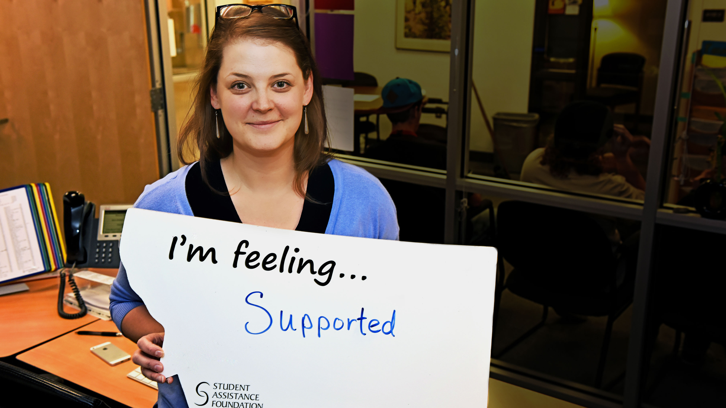
Gift aid: Scholarships
Do not have to be paid back
Awarded on basis of merit, skill, need, or unique characteristic
Deadlines are non-negotiable
Examples: Elks Scholarship, MSU scholarships, etc.
Remember – you have to APPLY
Separate App from FAFSA!
Notes:
Not all scholarships are based on high grades or test scores. You can and should apply for every scholarship you can.

Slide 41

Gift Aid: Scholarships
92% come from local resources & the college you attend
High School counselors
College Financial Aid website
Admissions Offices
Small scholarships add up … sometimes to $1.4 Million
Notes:
The student in this picture (Colter Norwick from Columbia Falls) received $1.4 MILLION in scholarship offers last year. He couldn’t take all of them since they came from different schools he applied to, but he did fully fund his first year at Duke with NO LOANS.
The point is . . .
Searching and applying for scholarships is hard work –but worth it!
Small scholarships add up! Make scholarship applications your summer job – if you spend 2 hours on a scholarship app and receive $1,000, that’s $500 an hour.
Admissions offices can and do award merit scholarships based on your admissions app (grades, ACT/SAT) as a recruitment tool – get application for admissions in early to your preferred schools.

Slide 42
Gift Aid: Scholarships
Free internet searches
Use to supplement local, college apps
SCHOLLY! Ask me for your free join code or visit Smartaboutcollege.org
https://bigfuture.collegeboard.org
https://www.mus.edu/Prepare/Pay/Scholarships
Fastweb.com
Beware of scams - if it sounds too good to be true . . .
Notes:
Free internet searches are good but remember – now you are competing nationally.
Scholly available on our website at www.smartaboutcollege.org This scholarship search tool was recently featured on “Shark Tank” and provides a fast, easy way to search for scholarships. And it’s free! 3. Other searches available – never pay for scholarship info

Slide 43

Self-help aid: Work-study
Student earns money to help pay educational costs
Student work schedule does not interfere with classes
Can be on or off campus
Won’t appear on your statement as a credit – why?
Notes:
Diana from Helena
Marti Johnson, SAF
Student:
Work study must be earned by the student while at school. Paycheck disbursed on regular pay periods – money can be used to help with any expenses.
OTHER: Being a Resident Assistance (“R.A.”) in your dorm can earn you free room and board while at college. Usually open to upperclassmen. Check with your Residence hall office for more info

Slide 44
Self-help aid: Loans
Money borrowed to pay college expenses
Repayment begins after student leaves school
Free money first; borrow only what is really needed
Federal loans can be an investment in your future
Federal Direct Student loans 4.29%* no credit check/no denial
Parent (PLUS) Loans 6.84%* - Credit check, can be denied
If denied, student can receive additional loan funds
Private student loans (last resort) credit check, interest varies,
Co-signer often required
Notes:
** Student loan interest rates are fixed. These are current rates for 2015-2016. NEW RATES will be published around July 1, 2016 for the 2016-2017 school year. Your student’s interest rate will be different from the current rate.
Student loans for $5,500 – every freshman, regardless of financial need (remember eligibility requirements from FAFSA)
Only exception – If your student receives so much other aid that full loan is not needed – remember our community college example
No credit check, no co-signer, etc. Cancellation and forgiveness options
PLUS Loans – do go through a credit check
Private loans – usually require a cosignor; rate is usually variable and affected by credit rating

Slide 45
How do I apply for a Federal loan?
Complete the FAFSA
Go through awarding process at your school
If you are offered a Federal loan, accept minimum amount possible
Accept any Subsidized loan offers first – Why?
Complete the Master Promissory Note (MPN) @ studentloans.gov
Complete entrance counseling at studentloans.gov
Any other requirements from your school
Notes:
Sub loans – interest paid for student while in school
No payment required if unemployed (up to 3 years), or temporary hardship (3 years) and interest paid during those times

Slide 46
How Much Can I Borrow?
Grade Level | Subsidized may not exceed 4.29%* | Unsubsidized 4.29%* | Annual Limit
1st year | $3,500 | $2,000 | $5,500
2nd year | $4,500 | $2,000 | $6,500
3rd year and beyond | $5,500 | $2,000 | $7,500
AGGREGATE LIMIT | $23,000 |  | $31,000
How much SHOULD you borrow?
Notes:
Borrow only the very minimum of what you need
Make and Follow a budget
Don’t borrow more than your job can repay! Payments should be no more than 8% of your pay – If you are paid $2,000 per month, your student loan payment should not exceed $160 a month.
Now is the time to live like a college student – cheap furniture, tight budget, Ramen noodles, etc. Live like a college student NOW, so you don’t have to when you graduate!

Slide 47
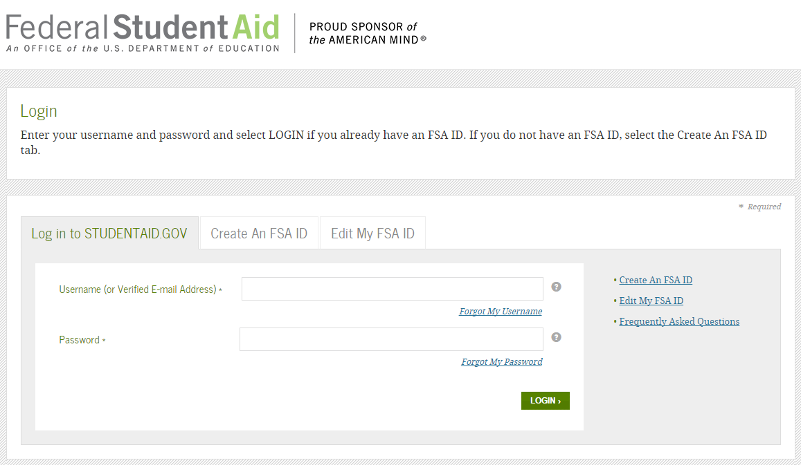
New This Year – FSA ID
Sign FAFSA electronically
Replaces the PIN number
Used throughout college years for federal loan applications, records access & linking to IRS
The student and one parent need an FSA-ID
Do not share your FSA-ID with ANYONE
Website: https://fsaid.ed.gov
Notes:
In order to receive financial aid, you must first apply for a Federal Student Aid ID.
The student and one parent need to have an FSA-ID to complete the FAFSA and other aid documents (MPN, access NSLDS)
Parents, do not apply for an FSA-ID for your child – and students, do not apply for your parent. Each person applies for his/her own FSA-ID
The FSA-ID acts as a legal, binding signature when signing electronic federal aid documents such as FAFSA and student loan promissory notes (MPNs)
Apply before College Goal Montana so you will be ready to go! Sometimes the process takes longer than expected, so make sure you have your FSA-ID before you come to College Goal MT to complete your FAFSA.

Slide 48

New This Year:
Prior Prior Year (PPY)
For 2016-2017 FAFSA, use 2015 income info
The PRIOR year
Estimate if necessary using 2014 tax form,
2015 W-2s, pay-stubs, etc.
File beginning January 1, 2016 for
fall 2016 entry into college
For 2017-2018 FAFSA, also use 2015 income info
The Prior Prior Year (PPY)
No estimate necessary; taxes complete
File beginning October 1, 2016 for fall 2017 (Sophomore year of college)
Transitional year only – after 2016, FAFSA completion starts October 1
Notes:
TAYLEE from Crow Agency
Discuss PRIOR PRIOR YEAR –TRANSITION YEAR WILL BE THE HARDEST. MANY MORE CHANGES COMING – AS THIS WILL AFFECT ADMISSIONS, SCHOLARSHIPS, EVERYTHING. . . STAY TUNED

Slide 49

Special Circumstances
Cannot be documented using FAFSA
Contact financial aid office
Follow the procedure at your school
Adjustments at Aid Officer’s discretion – documentation required
Examples:
Loss of job
Death of wage earner
Divorce
Certain medical bills not covered by insurance, tax deduction or medical flex accounts
Special conditions considered only after initial awards have been determined
Notes:
Two types of Special Conditions – both determined by the Financial Aid Administrator at your school.
Loss of income or extraordinary expenses
Exceptions for being considered dependency (next slide)

Slide 50
Special
Circumstances
Exceptions for dependency:
Abandonment
Abuse
Neglect
Student answers “no” to all dependency questions on FAFSA
Marks “I will not provide parental data”
Contact the financial aid office for assistance
Document
Notes:
NOTE: This slide is also SLIDE 17 by Dependency questions – you can show in either site. Hide or delete alternate location
In cases where safety of student would be compromised by contacting parents, the student can contact the financial aid office for assistance in establishing independent status. Documentation required.

Slide 51

Other Forms . . .
CSS Profile
Verification forms
Admissions forms
FERPA – Release
Dorm Deposits
Meal Plans
Payment contracts
Notes:
Many, many trees will be killed before this process is over. . .
CSS profile – used by SOME private schools. Unlike the FAFSA, the CSS profile is a lot longer and asks for more information about your income, assets – even non-custodial parent’s income may be requested. This is for private schools – NOT required for public colleges and universities. Private schools they can ask for extensive income info because they ARE private – and have private funding to award.
Admissions – most schools will not provide an award letter unless you have applied for admission; many require a completed admissions app before aid will be awarded.
FERPA – once their child turns 18, parents can no longer receive educational information from the schools – not a grade report, whether they are attending class, etc. Suggestion: have student sign a release authorizing you to request info from the school.
Dorm deposits – usually do early – spring of senior year – be on time!
Meal plans – there are several to choose from. Remember students may not be eating breakfast on weekends (sleeping in) or maybe even dinner – (gotta have a pizza at college SOMETIME) Maybe a less expensive meal plan with limited weekend meals will do?
Payment contracts – many schools will let you pay a balance owed over the course of the semester. There may be a finance charge. See the business office.

Slide 52

Other Resources - Foster Care ETVs
2500 Montana foster care youth
Independent on the FAFSA
Receive up to $5,000 a year
ETV applications due:
Dec. 15 2015 for spring or summer enrollment
July 15, 2016 for fall enrollment
Application @
http://www.smartaboutcollege.org/foster-care/
Students who have “aged out”
Students in foster care
Students adopted from foster care or appointed a guardian after age 16
Notes:
Foster youth face additional challenges when transitioning from high school to college. Since they “age out” of foster care at age 18, many find themselves out of the foster home, on the street, and without parental guidance , assistance or support when trying to navigate the financial aid process. Student Assistance Foundation can help! If you know a foster youth, have a foster youth in your home, please share this information. If you are a foster youth, please contact Student Assistance Foundation for assistance.
ETVS are EDUCATION TRAINING VOUCHERS . They are grants which do NOT have to be paid. If a foster student received a full Pell ($5775 for 2015-2016) and a full ETV Grant ($5000) – they are already awarded almost $11,000 in funds for school that DO NOT HAVE TO BE REPAID!

Slide 53
Other Resources for Foster Care Youth
“A Step Ahead” Camp
Montana Tech campus
June 20 – 24, 2016
Live on campus
Learn about campus life
Life skills
Managing money
Financial aid
College success
Did we mention a free computer for college?
Find out more @
http://www.smartaboutcollege.org/foster-care/
Notes:
STEP AHEAD:
Youth in foster care learn college access information and valuable life skills at this free, five-day summit held every June at a Montana postsecondary institution. Youth stay in the dorms, attend “classes,” eat in the cafeteria, and experience college life firsthand. In addition, they learn life skills including how to find and maintain housing, build relationships, obtain employment, and manage money.
As an added benefit, participants take home a free laptop computer to assist with postsecondary education, or a “life preparation” package to help them get ready for, and transition to, independent living.
For more information about “A Step Ahead,” contact Rhonda Safford at (406) 495-7750 or email rsafford@safmt.org, or John Schroeck at (406) 841-2469 or jschroeck@mt.gov.

Slide 54

Other Resources
College Goal Montana
Get help completing the FAFSA in time for the March 1 priority filing date (Feb. 15 for U of M
SmartAboutCollege.org
Click on “College Goal Montana” for an event near you
Notes:
Riley from Butte

Slide 55

College Goal Montana
YOUR High School HERE
Get help with the FAFSA
YOUR DATE TIME HERE
YOUR BUILDING ROOM ETC
Get your FSA-ID first!
Notes:
Deanne from Kalispell

Slide 56
Other Resources
Montana Money Magic
Savings program for high school
MESA - “Matched Education
Savings Accounts”
Savings programs for college
Tribal, BIA funding
SRS/Voc-Rehab
Tax credits/deductions
Notes:
Rex from Helena
Montana Money Magic – for high school students - See next slides
MESAs- for Montana college students
Tribal/BIA – apply early for limited funds
SRS Voc-Rehab – documented disability/ educational adaptive assistance
Tax credits and deductions: American Taxpayer Relief Act extended through 2017 - help with higher education expenses
AOTC - American Opportunity Tax Credit -
Replaces Hope Tax Credit
Can claim credit for four years instead of two year
Deductions – can deduce Student Loan Interest paid in tax year
Talk to your tax accountant

Slide 57


Montana Matched Education Savings
http://www.montanacreditunions.coop/matched-savings-accounts

Slide 58
What is Montana Money Magic?
Program goals:
Increase overall financial knowledge and understanding
Help participants reach their educational goals
Program Guidelines:
Financial Education program-~ 16 hours of financial literacy
Match savings account-$3:$1 with a max of $1350 in match
Student earn approximately $64/hour to learn financial education
smartaboutcollege.org/saving/

Slide 59
Montana Money Magic Qualifications
Be between the ages of 16-19
Be attending high school in Montana in one of six participating geographic regions
Students pursuing the Hi Set are also eligible
Complete the Montana Money Magic financial education program
Have earned income to generate their own savings
Meet income eligibility

Slide 60
Eligibility Chart
For families or households with more than 8 persons,
add $4,160 for each additional person.
1

Slide 61
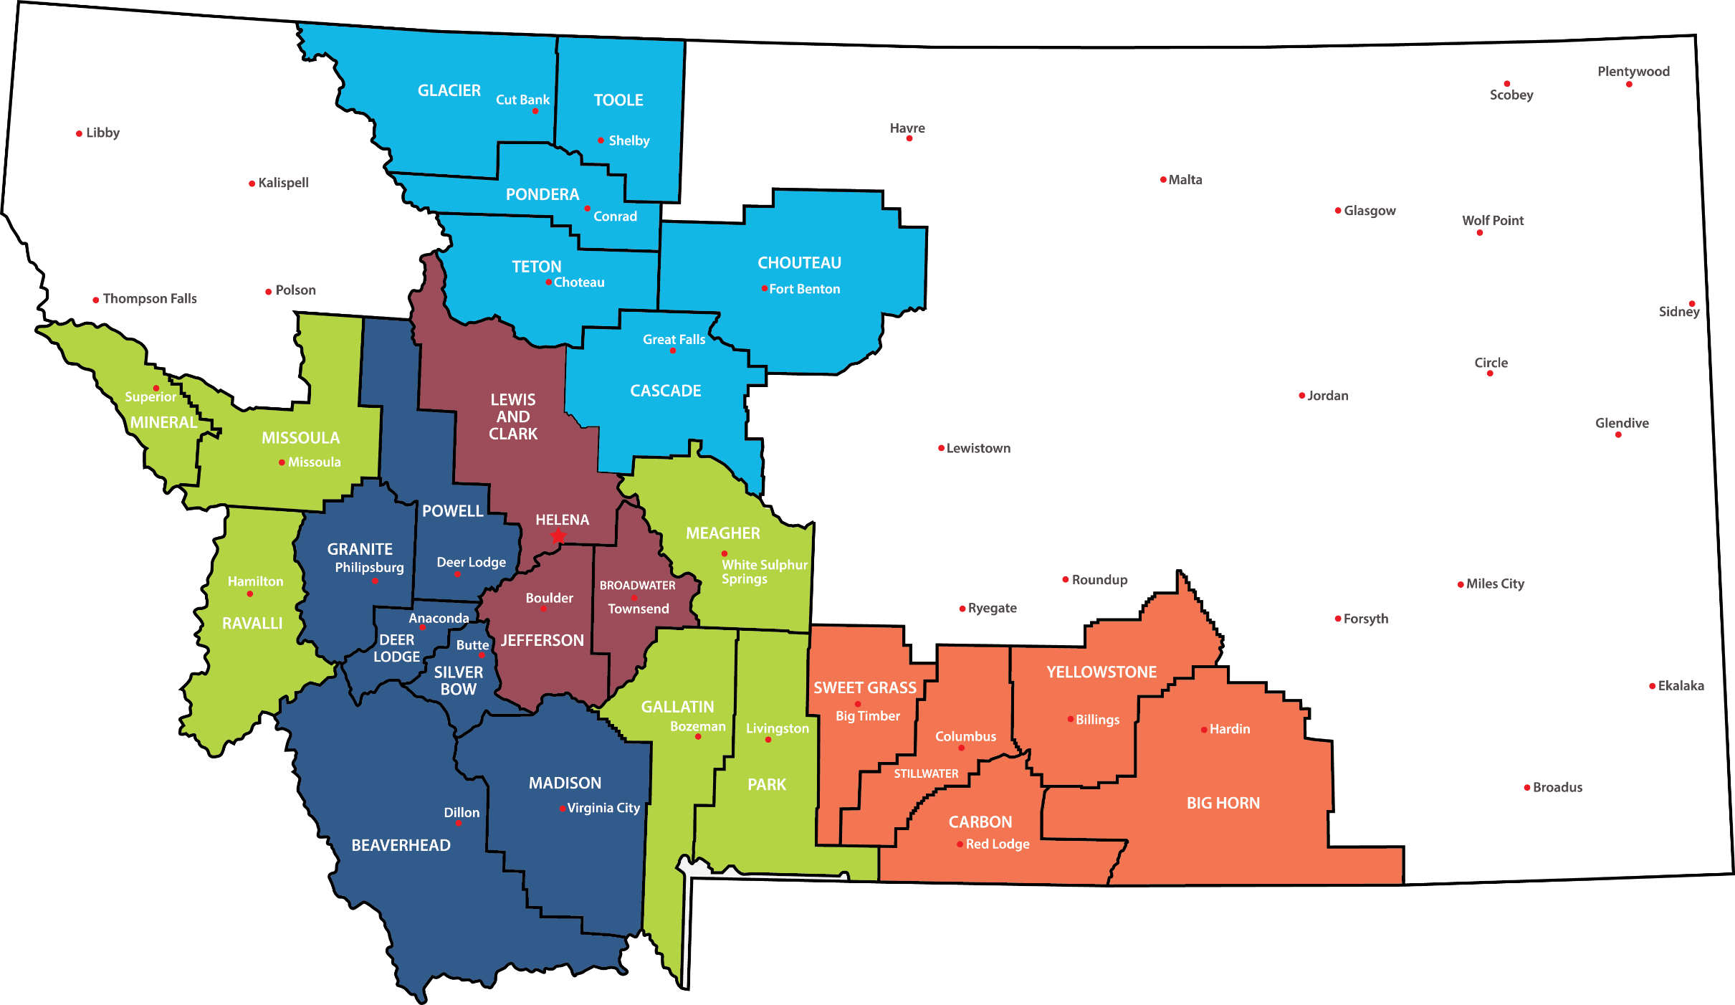



Slide 62
Who do I contact to learn more?
Gallatin, Park, Meagher
Katherine Foster, (877) COLG4ME (265-4663)
Press 1, then press 2
Broadwater, Jefferson, Lewis & Clark
Marti Johnson, (877) COLG4ME (265-4663)
Press 1, then press 5
Glacier, Toole, Pondera, Cascade, Choteau,
Teton
Allen Heisler , (877) COLG4ME (265-4663)
Press 1, then press 6
Missoula, Ravalli, Mineral
Ellen Smith (877) COLG4ME (265-4663)
Press 1, then press 1 again
Big Horn, Carbon, Stillwater, Sweet Grass,
Yellowstone
Jennifer Almli (877) COLG4ME (265-4663)
Press 1, then press 3
Silver Bow, Deer Lodge, Beaverhead, Madison
Powell, Granite
Schylar Canfield-Baber (877) COLG4ME (265-4663)
Press 1, then press 4

Slide 63

Other Questions to Ask
Is this scholarship renewable? How?
What is your priority date?
Are there any other options for me?
Payment arrangements
Asking for additional funds
Asking for help
Notes:
Linda Kaps, HS Counselor – Columbia Falls
“Are there any other options?” can be a question for many situations in college – options for paying a balance on your bill; options for additional funding offers, etc. It doesn’t hurt to ask. Private schools are more likely to add additional awards than public institutions– especially if they really want to recruit your student. Public universities such as UM or MSU do not have the same flexibility or even the same level of funding as a private school might have – but it doesn’t hurt to ask.
Asking for help – tutoring, mental health counseling, support – talk to someone if you have a problem. Get the help you need to be successful in college.

Slide 64

How does
the bill
get paid?
Funds go to student’s school account – not to student
School charges paid first
Federal aid is disbursed equally by semester/ trimester (also most scholarships)
Refund check/ACH/debit card issued if credit balance
You pay if balance due
Make a budget/make it last
Notes:
Note: Some schools will allow the student to charge books at the school bookstore and pay with their financial aid. ASK.
Disbursement – by semester (1/2 fall, ½ spring) or over three trimesters if the school is fall, winter spring
SUMMER aid is usually awarded separately at the END of the award year, but some schools START their award year with summer session. Find out.
Generally the next disbursement is at beginning of the next term, or even the middle of first month back at school after the holiday break – some schools do not disburse refunds until 30 days after the start of class
This is the time to sit down with your student and discuss how much they have to spend throughout the school term, so they will not run out of money!

Slide 65

Questions?
Thank you!
PUT OWN PICTURE SLIDE
YOUR EMAIL
YOUR PHONE NUMBER
Notes:
Connor from Columbia Falls
Mary Howard from Student Assistance Foundation
For a copy of the presentation, contact me (or ask if they can ask the counselor)

Slide 66


Ready?
Notes:
Darla from Hardin

